Slide 1
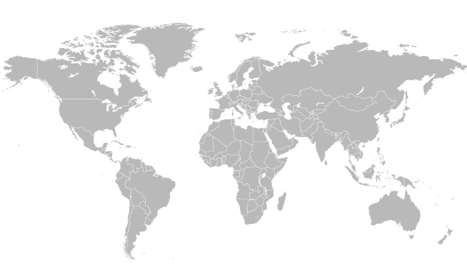
Measuring the Global Routing Table
by
Alexander Afanasyev, Brent Longstaff, Neil Tilley
June 2, 2009

Slide 2
Outline
Data sources
Announcements, allocations, IP space usage
Routing table growth factors
Prefix length
Longevity of announcements
Fragmentation
Routing table stability
Conclusion

Slide 3
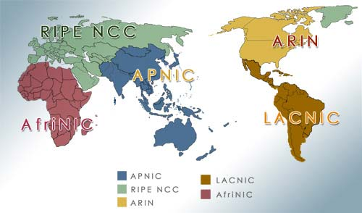
Source for IP allocation history Regional Internet Registries (RIRs)

Slide 4
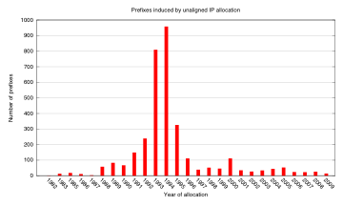
Unaligned IP allocations
Most of unaligned allocations are from the 90s
Unaligned blocks are still allocated

Slide 5
Source for BGP announcement history BGP monitors
Two BGP monitor projects
Route Views of U Oregon
Routing Information Service (RIS) of RIPE NCC
BGP data collected throughout the world
Currently 24 collecting points
Monitors in US, Europe, Japan, Russia, and Brazil

Slide 6
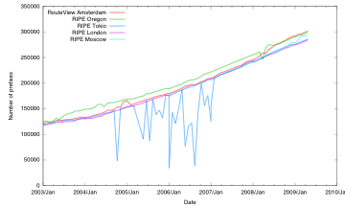
BGP source data Various BGP monitors
For most sources source data is consistent

Slide 7
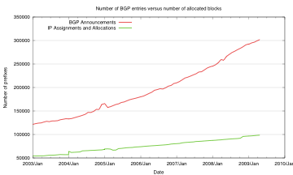
BGP announced prefixes versus IP allocated prefixes (BGP vs RIRs)
3.05
2.3
# of IP allocations increased 1.8 times
# of BGP entries increased 2.4 times
Notes:
BGP table more than doubled in 6 years
The BGP table growth outstrips IP allocation rate

Slide 8
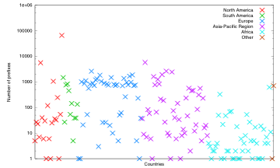
Distribution of BGP announced prefixes in 2003
America
Europe
Asia Pacific
Africa

Slide 9
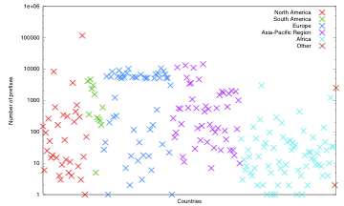
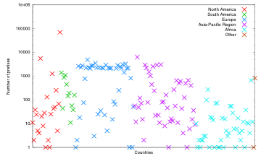
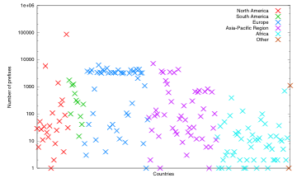
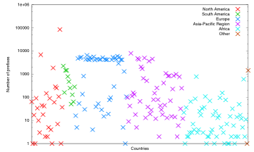
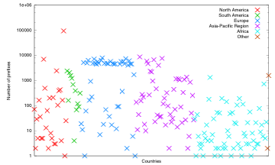
Distribution of BGP announced prefixes
2003
2004
2005
2006
2007
2009
General trend - substantial growth of # announced prefixes globally
Notes:
Almost every country is participating in BGP table growth.
Exceptions are unindustrialized countries

Slide 10
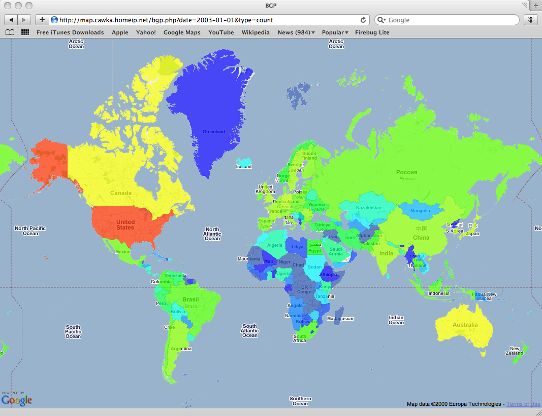
Distribution of BGP announced prefixes 2003 [1/8]
Exp scale
115k
6.3K
prefixes
340
18
0
Notes:
The best way to visualize geographical distribution of the BGP routing table is to use actual map. As you can on this slide we have managed to apply different colors to different countries according their share in the routing table. On the right you can see the exponential color scale. The red (the most hot color) represent the major impact, the blue – no or minimal impact (1-2 entries for country).
As we can see, the most impact US, Canada and Australia has the most considerable impact on routing table size in 2003. As it was expected, the least industrialized continent continent has the least impact on routing table size. In 2003 only South Africa, Nigeria, Kenya, Algeria and Egypt has some Internet connectivity
In next 7 slides we’ll see how distribution is changing over time period (from 2003 to 2009).

Slide 11
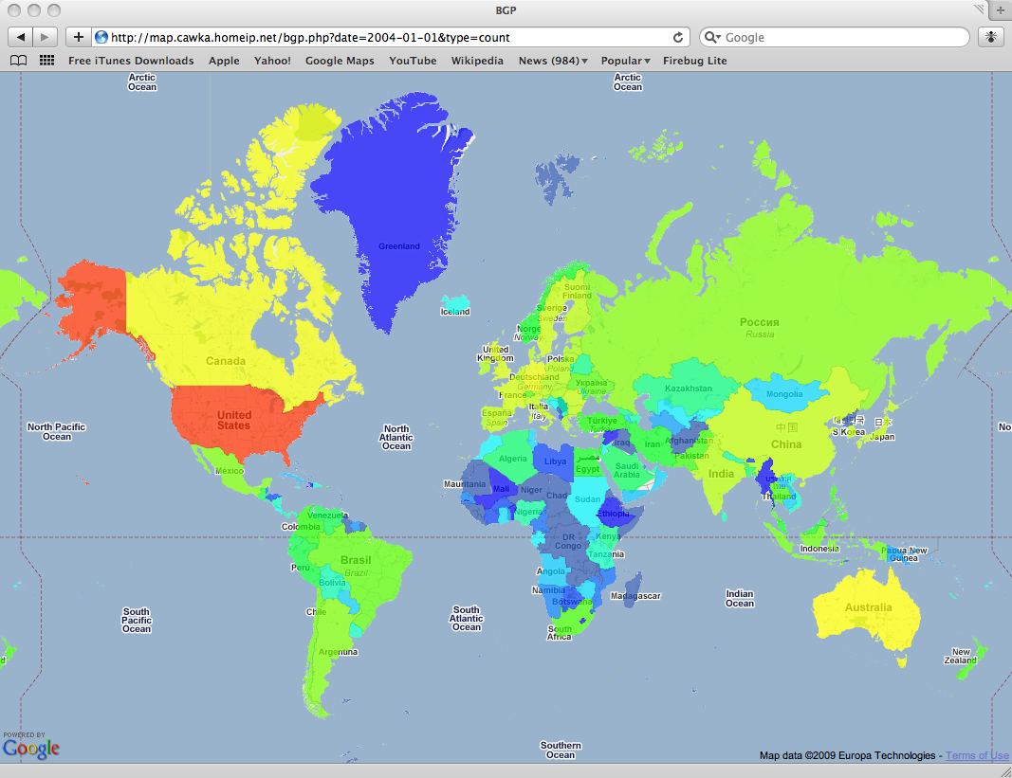
Distribution of BGP announced prefixes 2004 [2/8]
Exp scale
115k
6.3K
prefixes
340
18
0

Slide 12
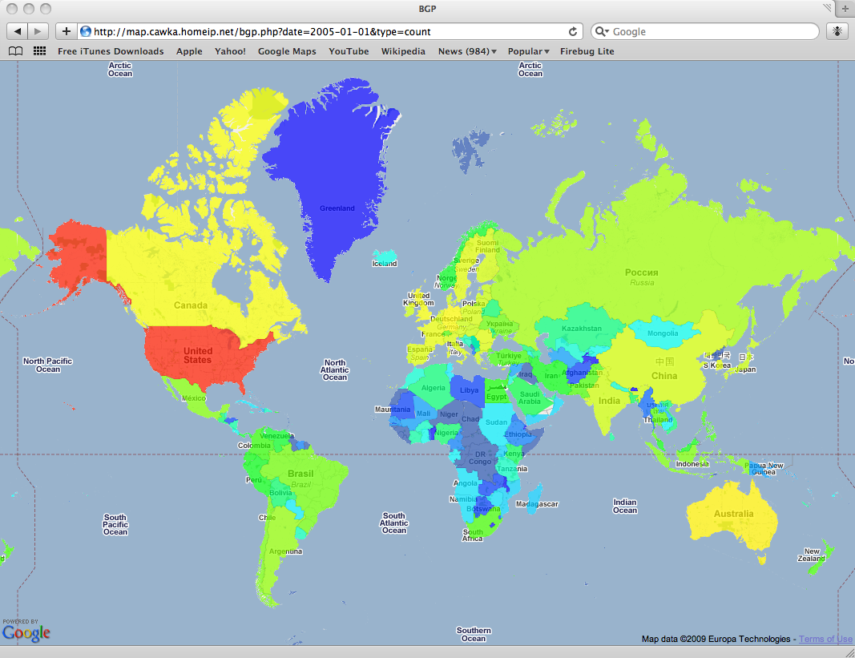
Distribution of BGP announced prefixes 2005 [3/8]
Exp scale
115k
6.3K
prefixes
340
18
0

Slide 13
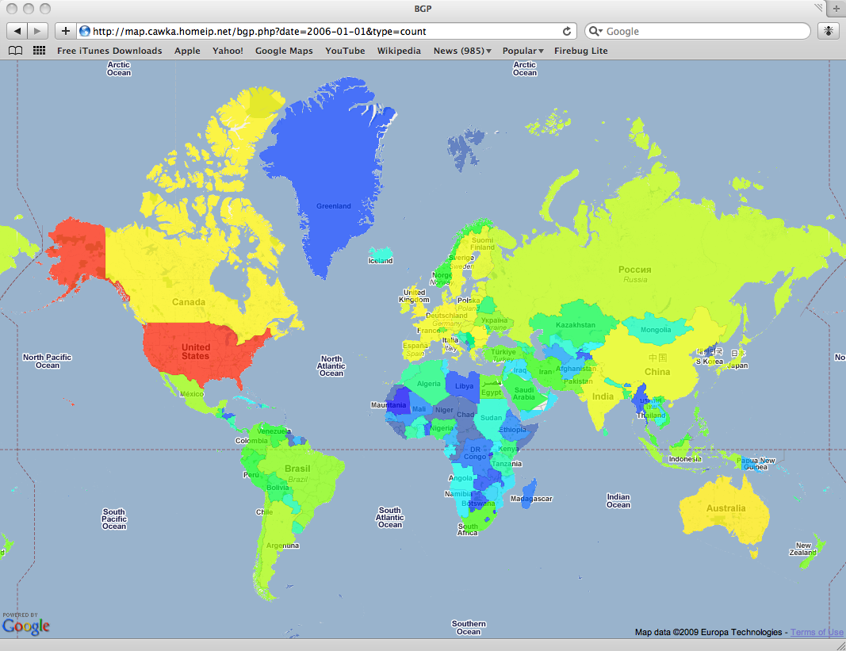
Distribution of BGP announced prefixes 2006 [4/8]
Exp scale
115k
6.3K
prefixes
340
18
0

Slide 14
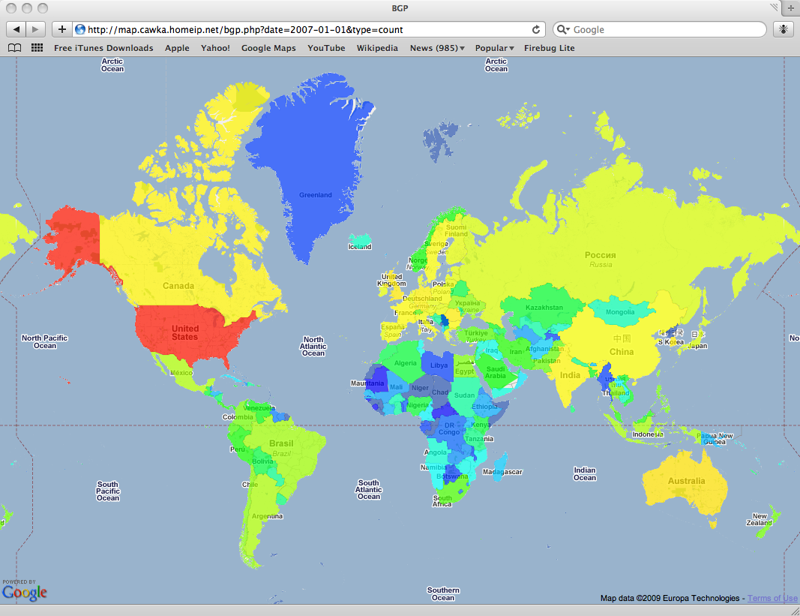
Distribution of BGP announced prefixes 2007 [5/8]
Exp scale
115k
6.3K
prefixes
340
18
0

Slide 15

Distribution of BGP announced prefixes 2008 [6/8]
Exp scale
115k
6.3K
prefixes
340
18
0

Slide 16
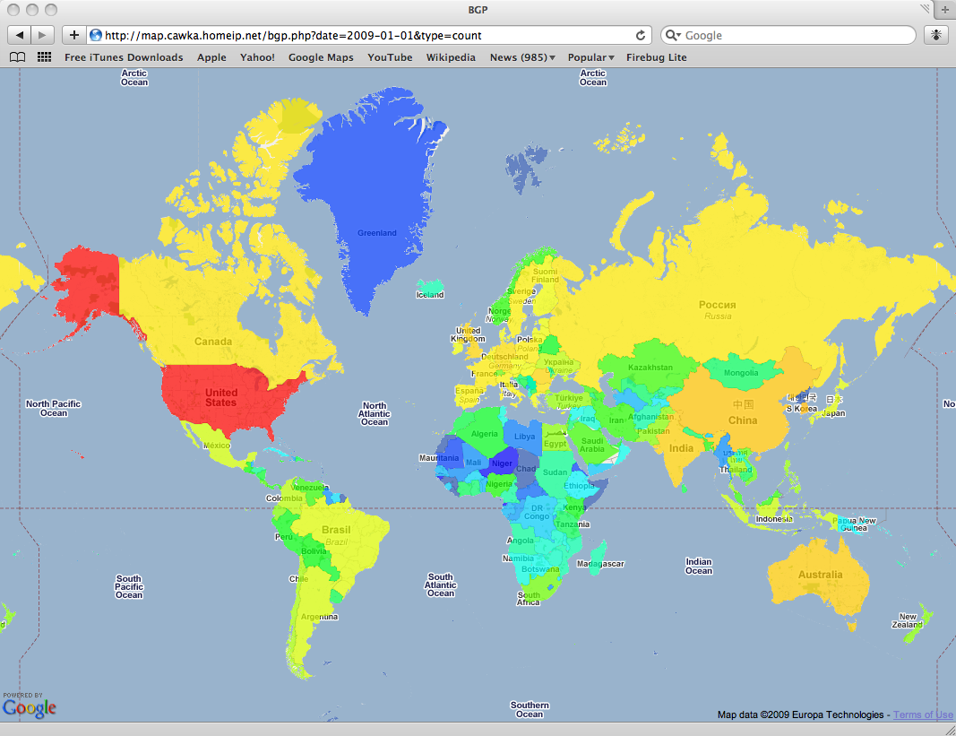
Distribution of BGP announced prefixes 2009 [7/8]
Exp scale
115k
6.3K
prefixes
340
18
0

Slide 17
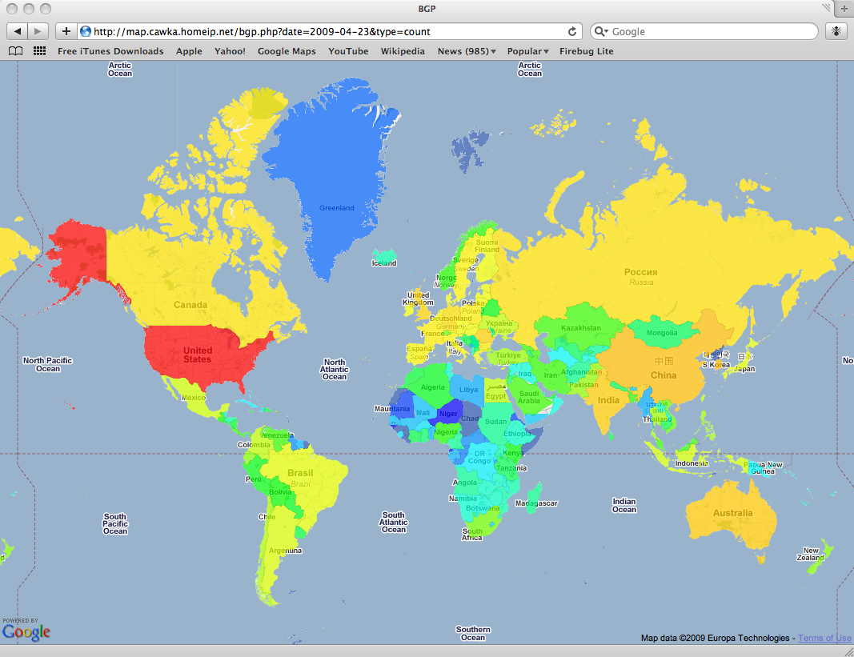
Distribution of BGP announced prefixes May 2009 [8/8]
Exp scale
115k
6.3K
prefixes
340
18
0
Notes:
In present days, US still has dominant role in BGP routing table. However, Ching and India considerably increased their share in routing table. It also should be noted, that the growth of BGP table is happening in all parts of the world. Not in the same scale, but still we can see future demands for IP addresses

Slide 18
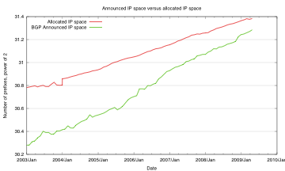
Allocated vs announced IP space
0.3%
1.7%
1. BGP table doesn’t cover all allocated IP space
2. There are globally unused IPs
Notes:
In next several slides we show the utilization of IP address space. Analysis of the gathered data draw very interesting conclusion. We have seen in first slides, that number of entries in BGP table (number of announced prefixes) is considerably higher than number of actually allocated blocks. But, the total address space which is announced (that is, BGP routers know how to reach all addresses from announced address space) is less than allocated. In other words, some IP addresses never appear in global routing table. From one hand this is not a surprise, surprising is different point.
The green line shows a size of IP space, which contains some duplicates. This is happening due to traffic engineering and multihoming techniques. Later we’ll show the impact of this techniques on BGP table size.

Slide 19
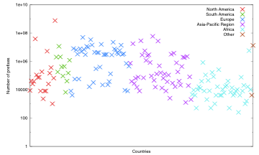
Distribution of announced IP space in 2003
America
Europe
Asia Pacific
Africa
Notes:
Just as point of interest in next few slides we present distribution of IP space across continents and individual countries. Each cross on this graph represent individual country and number of announced IP addresses, which are assigned to this country. We clearly can distinguish US, Canada, top european countries, Australia, China, South Africa.

Slide 20
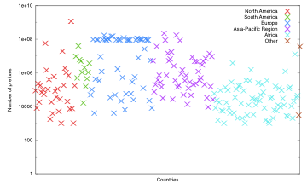
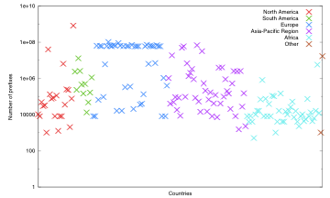
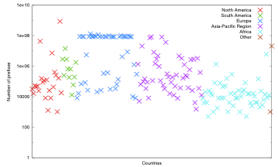
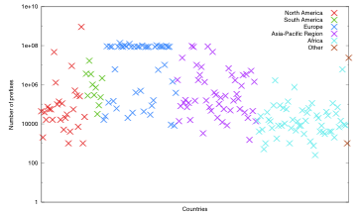
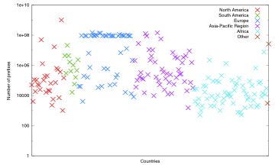
Distribution of announced IP space
2003
2004
2005
2006
2007
2009
General trend - growth of used IP space globally
Notes:
If we look at the same scatter plot, but in dynamics, we’ll see some IP space utilization growth. Similar to the number of announced prefixes, this growth is happening around the globe.

Slide 21
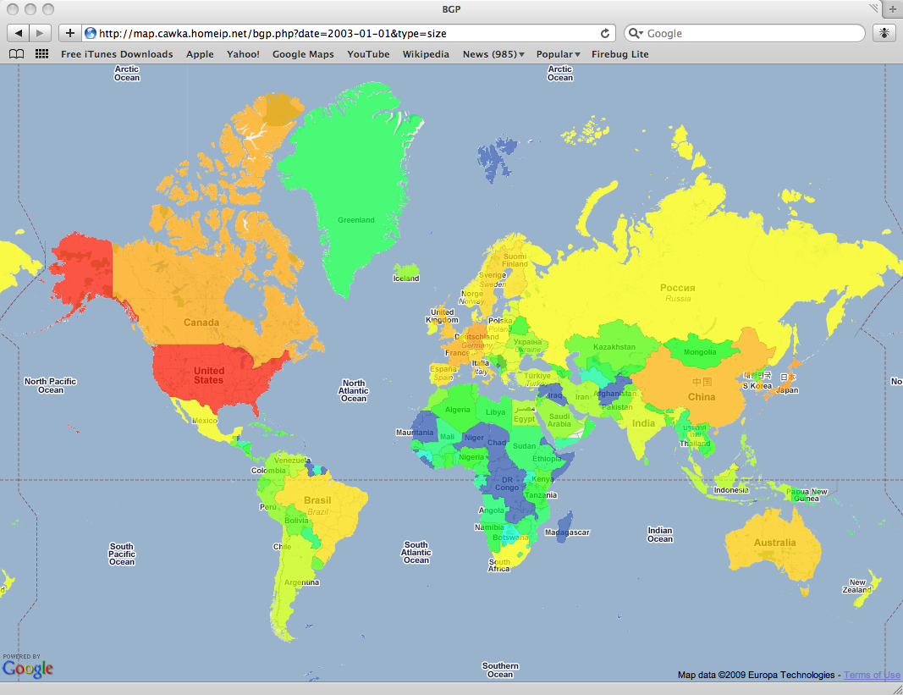
Distribution of announced IP space 2003 [1/8]
Exp scale
1.17b
6m
# of addresses
10k
184
0
Notes:
In next few slides we presenting the same information, but in different form. In 2003, as well as in other year, US has a dominant role in IP utilization. But the animation will show the unequal growth around the world.

Slide 22
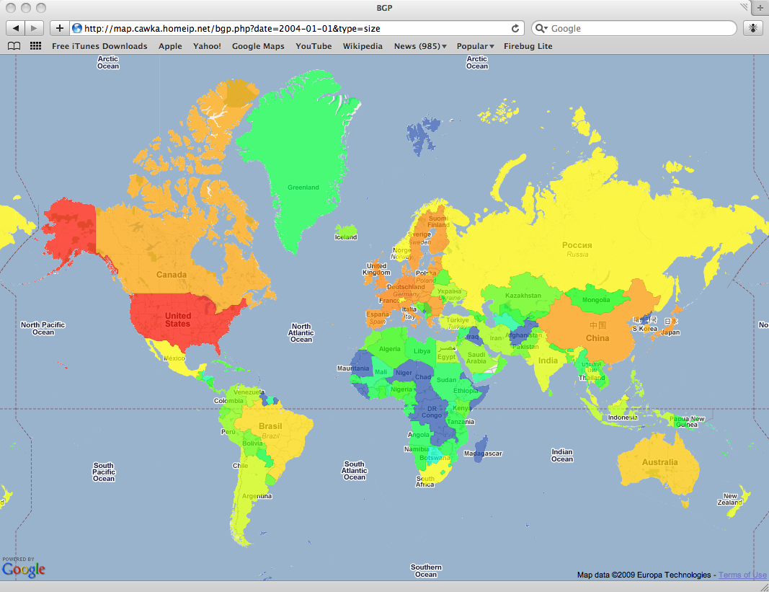
Distribution of announced IP space 2004 [2/8]
Exp scale
1.17b
6m
# of addresses
10k
184
0

Slide 23
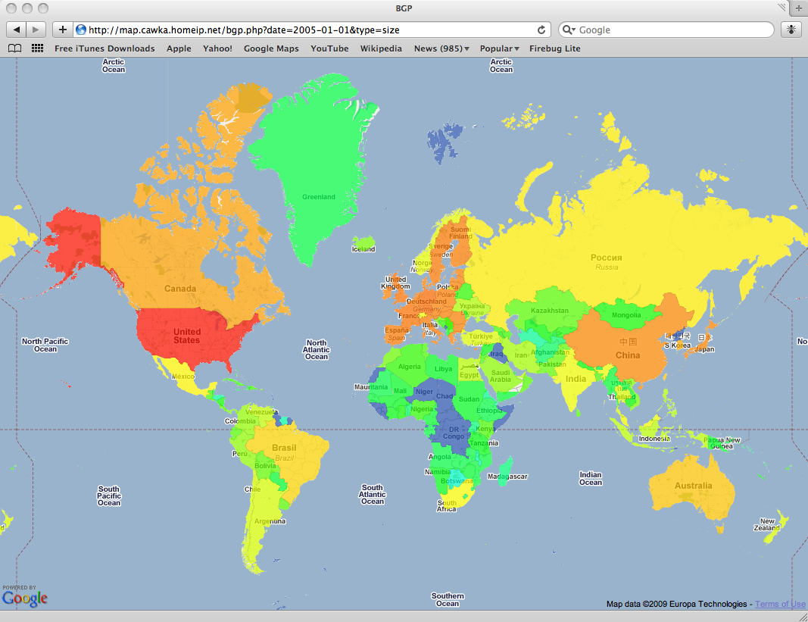
Distribution of announced IP space 2005 [3/8]
Exp scale
1.17b
6m
# of addresses
10k
184
0

Slide 24
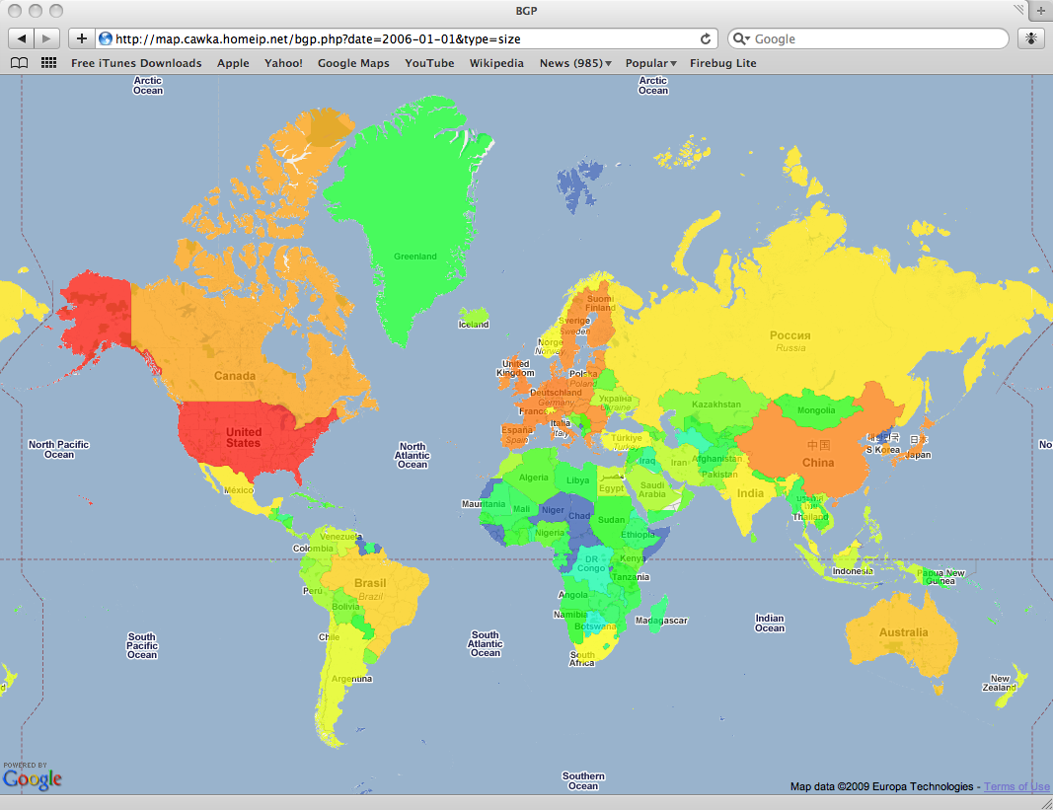
Distribution of announced IP space 2006 [4/8]
Exp scale
1.17b
6m
# of addresses
10k
184
0

Slide 25
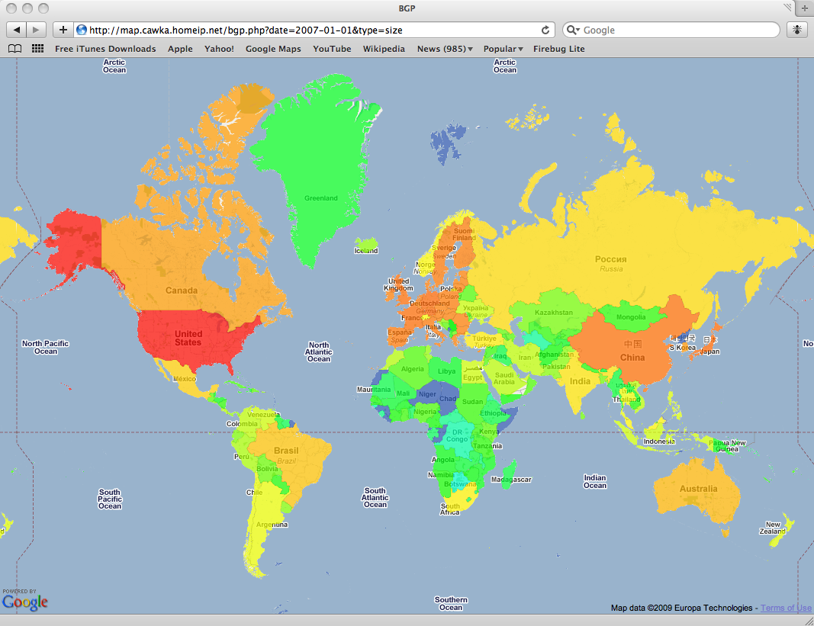
Distribution of announced IP space 2007 [5/8]
Exp scale
1.17b
6m
# of addresses
10k
184
0

Slide 26
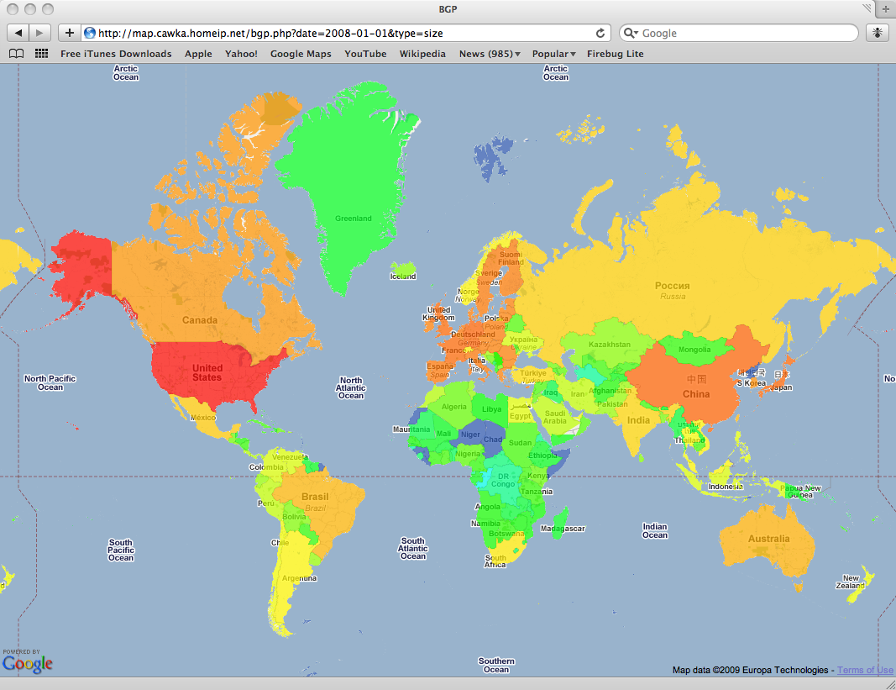
Distribution of announced IP space 2008 [6/8]
Exp scale
1.17b
6m
# of addresses
10k
184
0

Slide 27
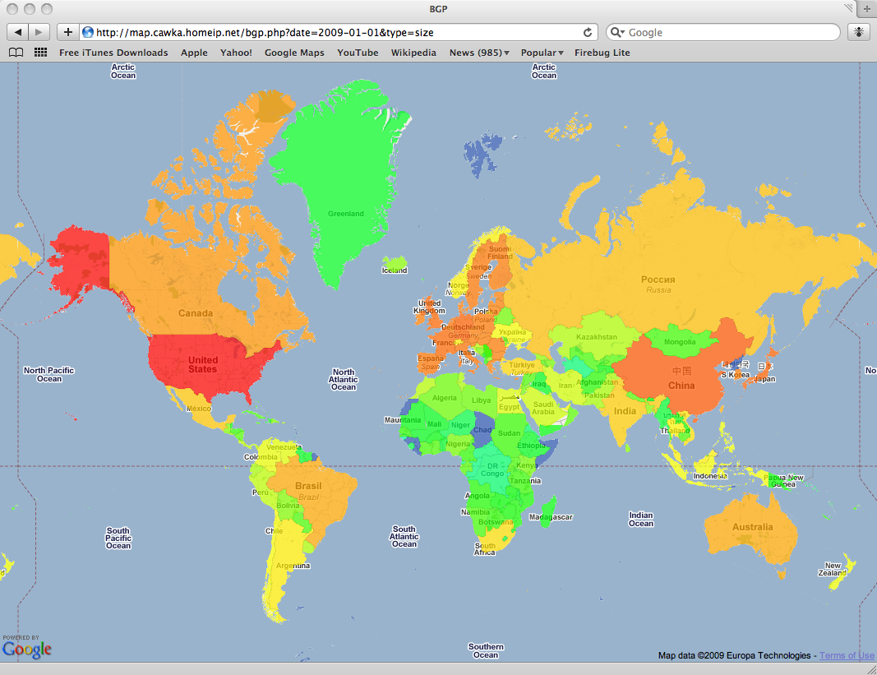
Distribution of announced IP space 2009 [7/8]
Exp scale
1.17b
6m
# of addresses
10k
184
0

Slide 28
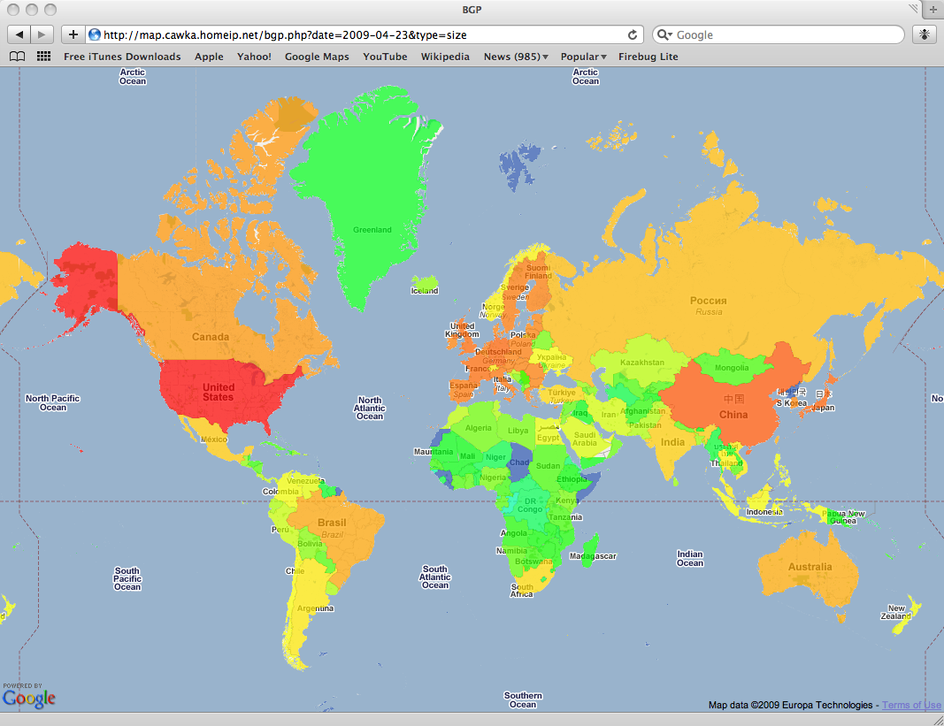
Distribution of announced IP space May 2009 [8/8]
Exp scale
1.17b
6m
# of addresses
10k
184
0
Notes:
Analogous to IP prefixes, China now has a second place for IP address utilization. Another point, we can make, that almost all countries in Africa, except Western Sahara, Guinea, Chad and Somalia has decent amount of announced IP space

Slide 29
Number of prefixes versus IP space
Number of prefixes
IP space
Exp scale
Exp scale
115k
1.17b
6.3K
6m
# of addresses
prefixes
10k
340
18
184
0
0

Slide 30
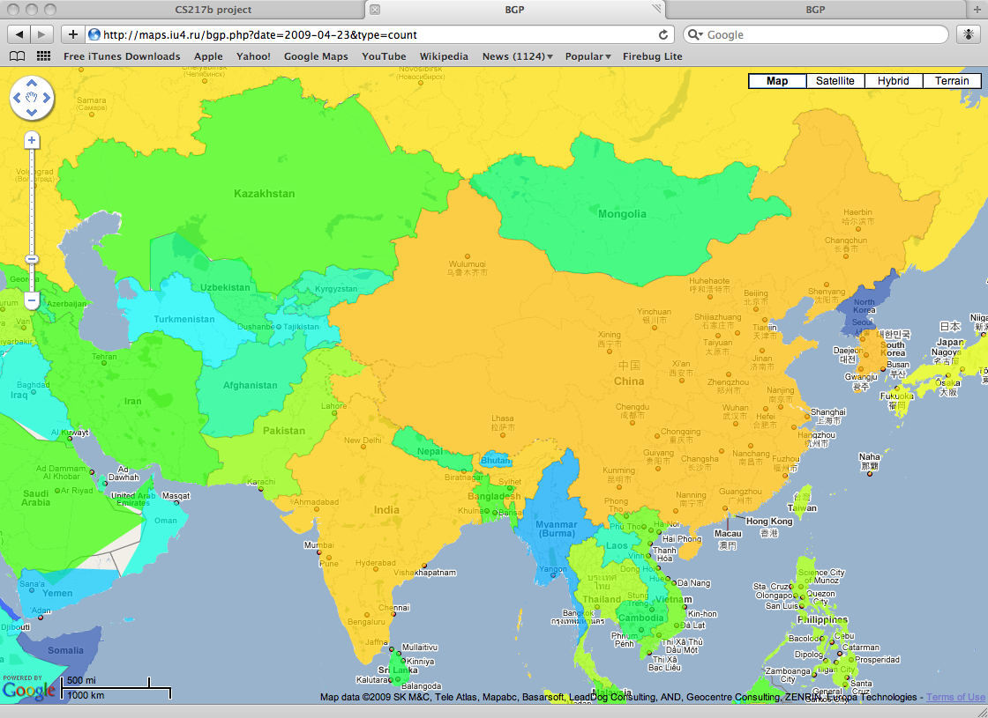
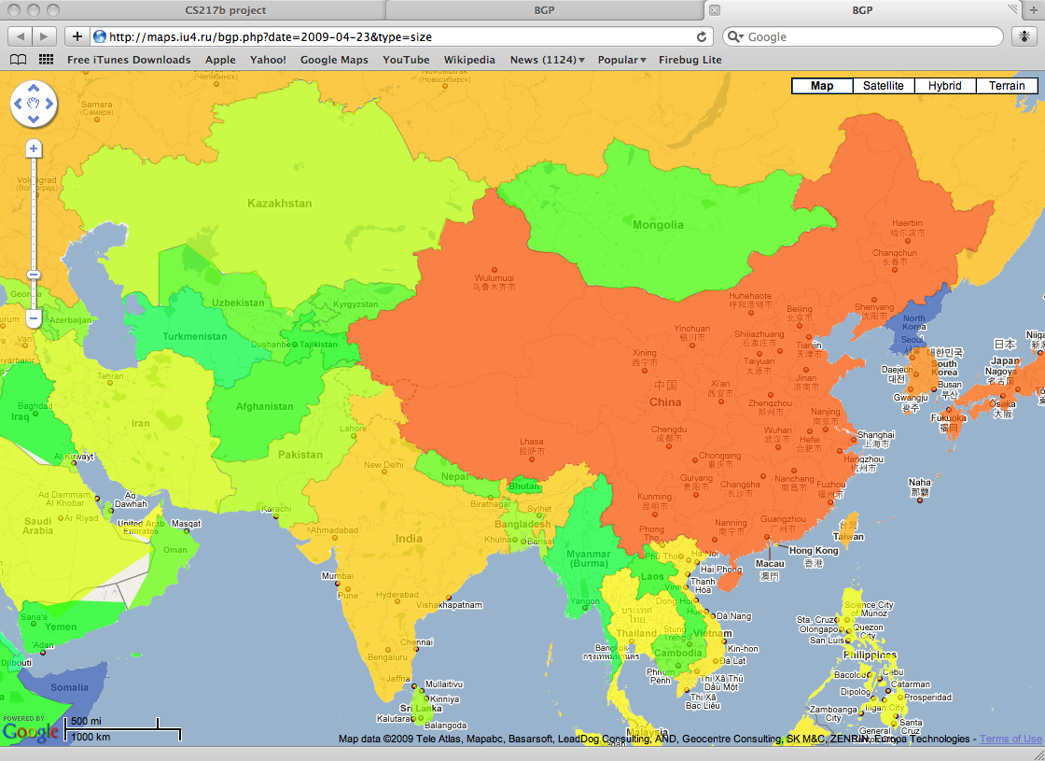
Number of prefixes versus IP space
Number of prefixes
IP space
Exp scale
Exp scale
115k
1.17b
6.3K
6m
# of addresses
prefixes
10k
340
18
184
0
0
Notes:
To emphasize a difference between announced IP space and number of announced prefixes, let’s look closer to the most recent colored Asia region maps. For example, we see that impact on routing table on routing table from China and India is kind of the same. Japan has even lesser impact on it. However, in IP space picture is absolutely different. China and Japan has the most announced IP space, and India moderate. As a conclusion, we can say that Japan has more efficient way to utilize IP space, that is less number of prefixes is required to covered bigger address space -> and as a consequence, smaller impact on actual routing table size.

Slide 31
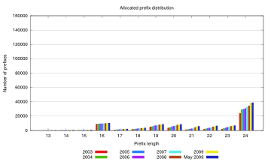
Distribution of prefix lengths IP allocations
Most of IP allocations are /24 blocks
Big number of allocations of /16, /19 and /20 blocks
Notes:
Fragmentation accounts for significant portion of BGP table growth
Let’s move from maps and get look on distribution of /24 in IP allocations and routing table. We chose this scale to help better understand the difference between allocations and announcements. As we can see, the most popular allocated size is /24. This also holds for BGP routing table. However,

Slide 32
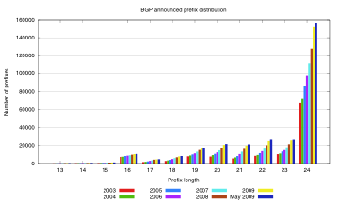
Distribution of prefix lengths BGP announcements
2.3x growth
in 6 years
Most of BGP entries are /24 blocks - 50%
/16, /19, /20, /21, /22 and /23 - the rest of 50%
Notes:
Fragmentation accounts for significant portion of BGP table growth (/24 blocks – >50% of BGP table)
The numbers are really different. BGP routing table accounts 6 times more /24 blocks than they were allocated. We can draw a conclusion, that ISPs prefer to fragment large allocated blocks into smaller, e.g., /24 prefixes account for more than 50% of routing table.
Now we’ll go in some details about how this can happen.

Slide 33
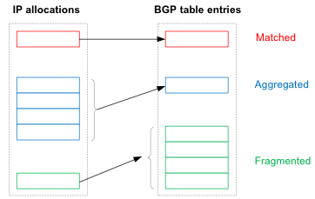
Some definitions
Notes:
Let’s define some basics terms. First of all, allocated block can be seen in routing table in exact form. That is, some ISP gets block of addresses from RIR and without modifications put it in BGP announcements. In different case, some ISP can get several consecutive IP blocks from RIR and use one BGP entry to represent them. We’ll call it ‘aggregated’. The last, and the most important type is ‘fragmented’. That’s ISP allocates one block, but represent this block with many small IP chuncks (e.g., to implement load balancing or multihoming feature)

Slide 34
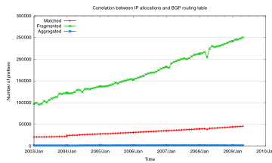
Impact of the fragmentation on the BGP routing table size
# of fragmented
5 times as many as
# of matching
BGP aggregation of allocated blocks is very rare (1400 – 2000 prefixes)
Notes:
We see, that significant number of announced prefixes are actually fragmented. Number of aggregations Is negligible. From the graph we can conclude, that even if RIR’s will come up with some smart allocation algorithms for allocation, ISPs are not really willing to aggregate IP blocks (red line is a target for this kind of actions). In other words, without real change in BGP protocol itself, the BGP table growth will continue at the same or higher level.

Slide 35
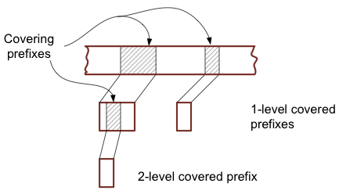
Another bunch of definitions
Notes:
To further investigate impact of load-balancing and multihoming techniques on BGP routing table size, let’s define two new terms. We’ll call some prefix as ‘covering’ if there exists some prefix, which is included in ‘covering’. The included prefix we’ll call a ‘covered’. Clearly, there could be (and in practice exist) several levels of covering.

Slide 36
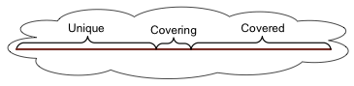
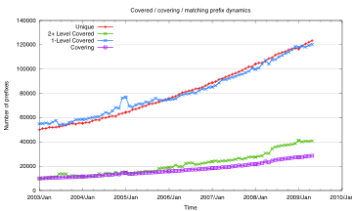
Duplication in BGP routing table Unique, Covered and Covering prefixes
1-level covered
Recently we see a growth of 2+ level covered prefixes
Unique
2+ level covered
Covering
Notes:
Multihoming and traffic engineering techniques introduce redundancy in BGP table (58% in 2009)
This slide shows the actual number of 1-level, 2+level, unique and covering prefixes. Unique prefixes are not likely to represent load balancing technique. But just a matter of organizing routing by ISPs. However, they still account slightly less than half of routing table size (i.e., this is a potential for optimization).
1-level covered prefixes accounts the other big share of routing table. The popularity of load-balancing, traffic engineering and multihoming in recent year is clearly visible from increasing trend of 2-level covered prefixes.

Slide 37
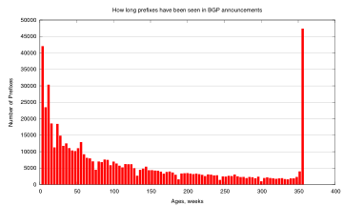
Longevity of BGP announcements
Many prefixes appear for very short time spans
A big part of the BGP routing table doesn’t change at all
>350
Notes:
BGP table is highly dynamic (only 16% is static)

Slide 38
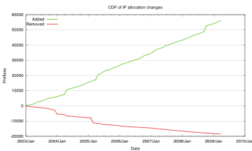
IP allocation and IP deallocation dynamics
Temporary artifacts

Slide 39
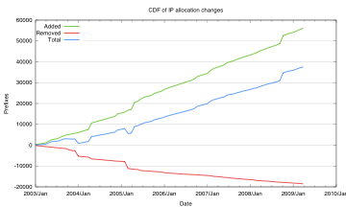
Resulting trends in IP prefix allocation
Total
Fewer deallocations than allocations
Notes:
Demand for IP addresses outpaces the rate IPs are returned to RIRs

Slide 40
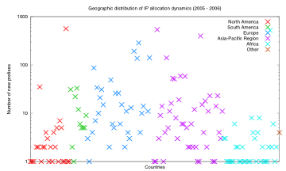
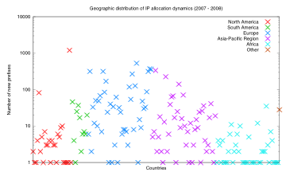
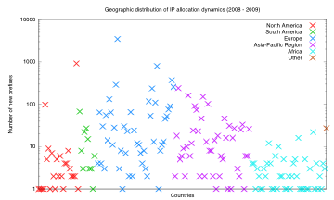
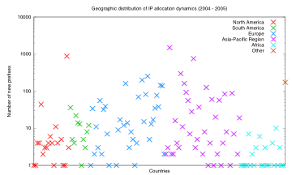
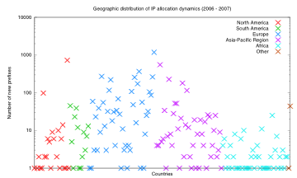

Year-on-year IP allocation changes by region
2003-2004
2004-2005
2005-2006
2006-2007
2007-2008
2008-2009

Slide 41

IP allocation changes geography 2003-2004
Exp scale
3.0k
400
54
7
0

Slide 42

IP allocation changes geography 2004-2005
Exp scale
1.5k
240
38
6
0

Slide 43

IP allocation changes geography 2005-2006
Exp scale
0.5k
115
24
5
0

Slide 44

IP allocation changes geography 2006-2007
Exp scale
1.2k
201
34
6
0

Slide 45

IP allocation changes geography 2007-2008
Exp scale
1.2k
201
34
6
0

Slide 46

IP allocation changes geography 2008-2009
Exp scale
3.5k
449
58
7
0

Slide 47
Conclusions
BGP table has more than doubled in 6 years
The BGP table growth outstrips IP allocation rate
Every industrialized nation is participating in BGP table growth
ISPs prefer to fragment large allocated blocks into smaller chunks, e.g., /24 prefixes account for more than 50% of routing table
Demand for IP addresses outpaces the rate IPs are returned to RIRs
Multihoming and traffic engineering techniques introduce redundancy in BGP table (58% in 2009)
BGP table is highly dynamic (only 16% is static)

Slide 48
Thank you
Is there any time for questions left?
Open for questions
Colored maps are available http://maps.iu4.ru

